Slide 1
Density Based Clustering of Earth-like Planetary Data
Final Presentation CS 472 and 572:
Brady Wisniewski and Joseph Laity

Slide 2
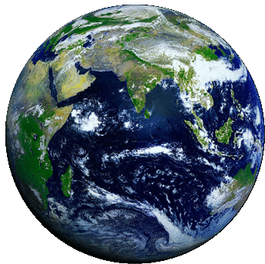
What we are trying to do
Use density based clustering on an Earth-like dataset
Find similarities between atmospheric makeup within that dataset
Use that to help differentiate within Earth-like planets
Help inform where is most likely to support life on discovered exoplanets
Notes:
This project looks at Earth-like planetary data and uses density-based clustering to group planets based on their atmospheric composition.
We’re trying to see which planets have similar mixes of gases like oxygen, carbon dioxide, and methane.
Once we group them, we can compare planets to each other and identify which ones are most similar to Earth.
The end goal is to help highlight planets that might have conditions suitable for life based on how similar their atmosphere is to Earth’s.

Slide 3
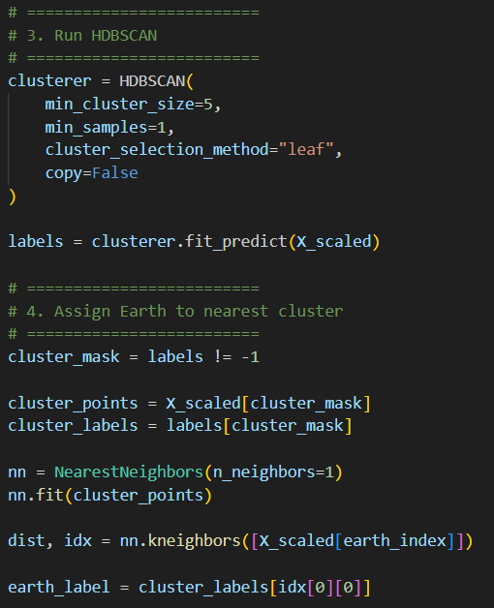
Implementation Update
Implementation is fully completed
Both DBSCAN and HDBSCAN are implemented
Complete output of both visuals and raw data to help analyze results
HDBSCAN a clear “winner”
Had to force include Earth due to high noise labeling
Notes:
At this point, the implementation is fully completed.
We successfully implemented both DBSCAN and HDBSCAN clustering on our dataset.
We also generated full visual outputs along with the raw cluster data so we can properly analyze and compare the results.
When comparing the two, HDBSCAN clearly performed better overall in terms of forming meaningful clusters.
One important note is that we had to manually assign Earth to a cluster because DBSCAN and HDBSCAN often labeled it as noise due to how strict the clustering can be with outliers.
*Explain code is HDBSCAN algo and assigning earth to nearest cluster*

Slide 4
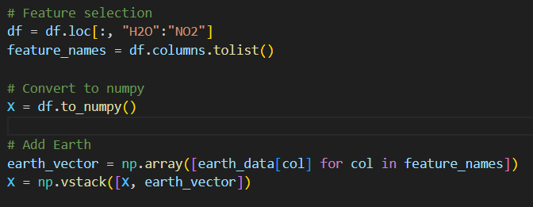
Preprocessing
Data gathered from the NASA expolanet archive from the PSG/INARA dataset https://exoplanetarchive.ipac.caltech.edu/docs/contributed_data.html
Seperated the First 1000 entries into two datasets
Cut down from 28 to 12 used dimensions
All features scaled
Added an approximate version of Earth to the dataset
H2O | CO2 | O2 | N2 | CH4 | N2O | CO | O3 | SO2 | NH3 | C2H6 | NO2
.010000 | .000420 | .207000 | .772000 | .0000019 | .0000003 | .0000001 | .00000007 | .00000001 | .000000001 | .000000002 | .00000002
Notes:
For preprocessing, we used data from NASA’s Exoplanet Archive, specifically the PSG and INARA dataset.
We took the first 1,000 entries and split them into two datasets for our experiments.
The original dataset had 28 features, but we reduced it down to 12 key atmospheric dimensions that were most relevant for clustering.
All features were then scaled so that no single gas dominated the clustering due to differences in magnitude.
Finally, we added an approximate Earth reference point so we could compare how similar other planets are to Earth.
*Data at bottom is earth data that we added*
*Explain code is isolating the features we want to use and adding earth to the dataset*

Slide 5
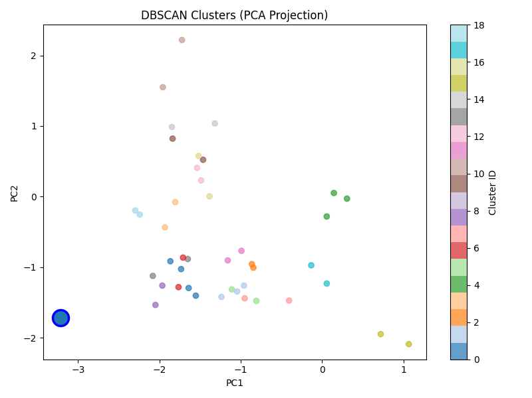
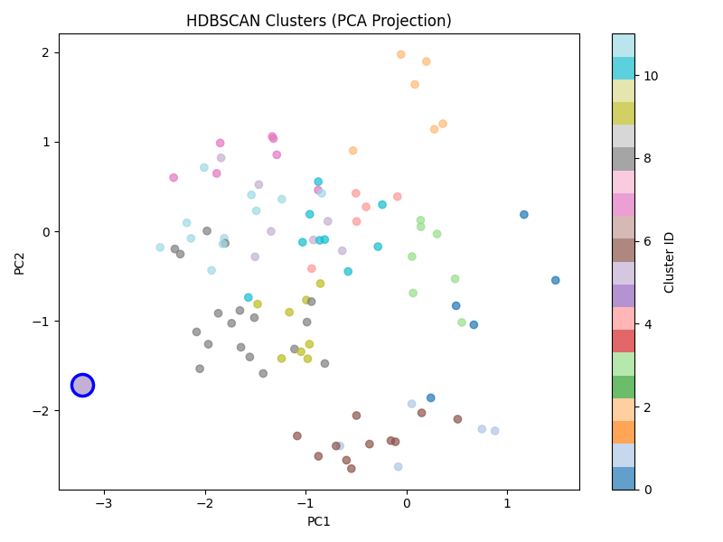
Initial Results
DBSCAN:
Earth clustered with 4 other exoplanets
HDBSCAN:
Earth clustered with 7 other exoplanets
Notes:
No overlap here between Earths clustered points
DBSCAN clustered 41 points into 19 clusters
HDBSCAN clustered 98 points into 12 clusters
FROM 500 POINTS

Slide 6
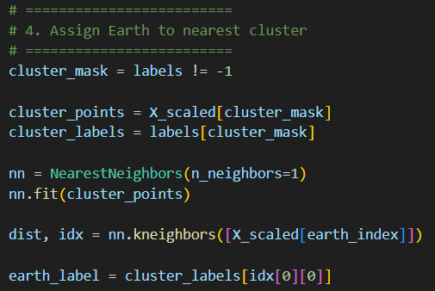
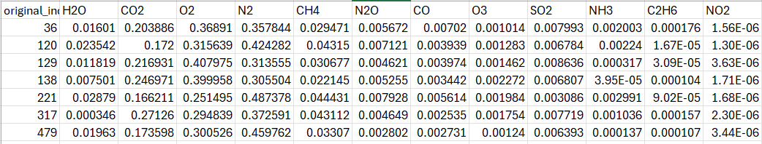
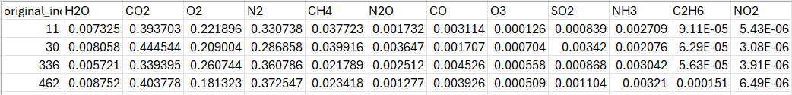
Insights
HDBSCAN:
DBSCAN:
Notes:
This code assigns earth to whatever its nearest cluster is
These are all the clusters that Earth was assigned as the most similar to
H2O (Water): Around 1%
CO2 (Carbon Dioxide): Around 20% and 40%
O2 (Oxygen): Around 35% and 20%
N2 (Nitrogen): Around 30 and 40%
CH4 (Methane): Around 3%
N2O (Nitrus Oxide): A bit all over the place below 1%
CO (Carbon Monoxide): A bit all over the place below 1%
O3 (Ozone)
SO2 (Sulfur Dioxide)
NH3 (Ammonia)
C2H6 (Ethane)
NO2 (Nitrogen Dioxide)

Slide 7
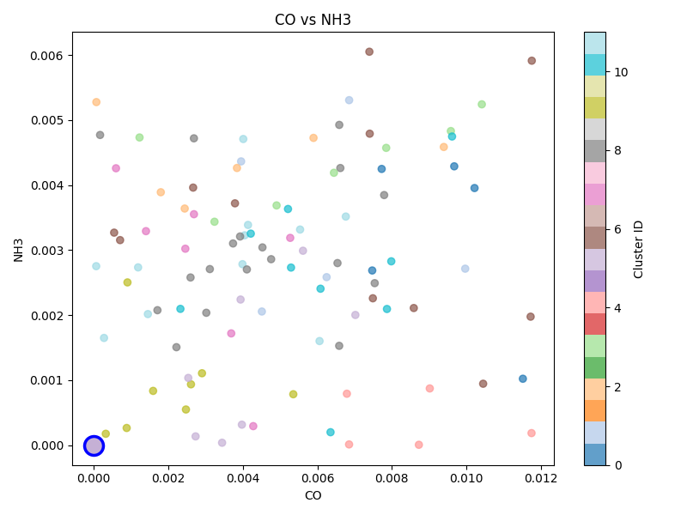
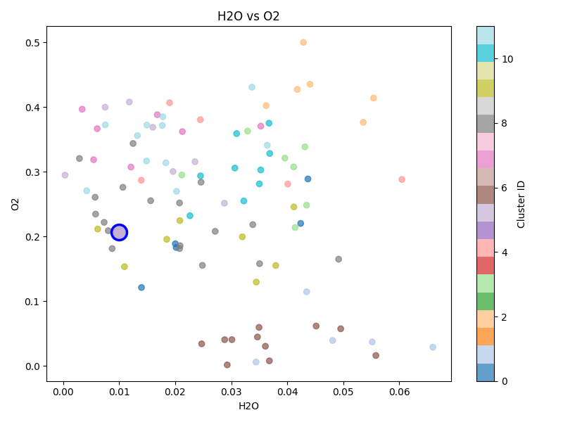
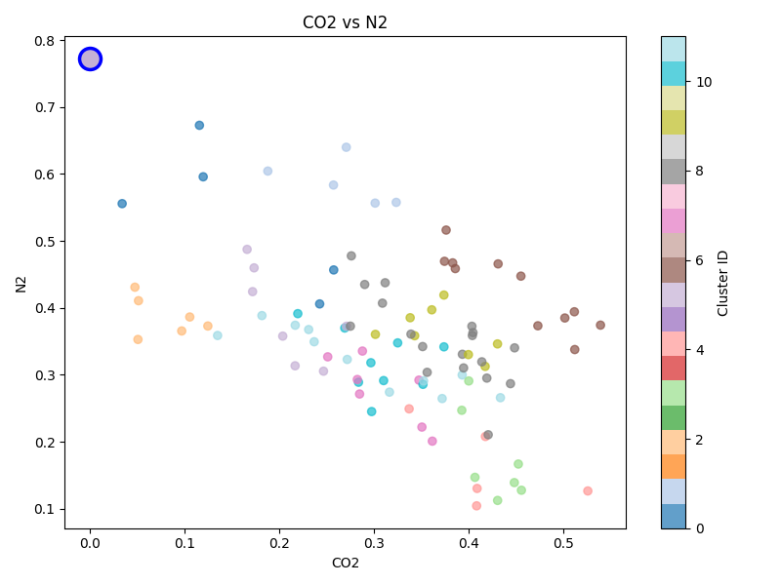
Meaningful vs not Meaningful Data
Notes:
Carbon Monoxide vs Ammonia
Clusters are all over the place, no real correlation between these data points and the clusters they were put in. This leads us to believing that the amounts of these is not meaningful towards the clustering process
Water vs Oxygen
Clusters are slightly more organized with included points around eachother more consistently than before. Still not perfect though. This is a great example of earth falling in line with its determined cluster though, which leads us to believe that the amounts of Water and Oxygen is very meaningful to finding similar planets to earth.
Carbon Dioxide vs Nitrogen
This is an example of clusters forming very good shapes between two different dimensions which lead to the conclusion that Carbon Dioxide and Nitrogen are also meaningful. However earth is very separated from its chosen cluster which leads to some questions on how correct these percentages are to a similar earth
All HDBSCAN clusters

Slide 8

Significance
Earth's Nitrogen rate higher than any exoplanet in the dataset
Earth's Carbon Dioxide rate in the bottom 5% of the dataset
Water, Oxygen, and Ozone rates very similar to Earth within cluster
Despite scaling, lower rate compounds have little effect on clustering process
Due to high density of the dataset many points we’re labled as noise in order to create meaningfully distinct clusters
DBSCAN struggles compared to HDBSCAN due to the high amounts of noise
Notes:
Points 1 leads to all other dimensions being lower on average
Point 2 doesnt fully make up for point 1, most other dimensions likely to be lower than most other points
Low Rate compounds are: Nitrus Oxide, Carbon Monoxide, Ozone, Sulfur Dioxide, Ammonia, Ethane, and Nitrogen Dioxide
HDBSCAN does better at making clusters with different shapes

Slide 9
Links
GitHub: https://github.com/Joseph-Laity/CS472-572-Final-Project
Website:
https://joseph-laity.github.io/CS472-572-Final-Project/

